Slide 1

Session 8
Selenium Framework Part 1

Slide 2
Knowledge Check
Session 7
What is TestNG? How it helps testers?
What are different ways to add TestNG into a java project?
What are important TestNG annotations?
What is dataProvider?
How you can execute tests in TestNG?
What is Maven? How it helps us?

Slide 3
Topics
Covered
Page Object Model(POM)
Framework Architecture
Reporting - Extent Report
Logging - Log4J
Data Management - POI & Properties file

Slide 4
Functional Scenario
Navigate to Guru99
Login Page
  Enter UID, PWD
  Navigate to Homepage
HomePage – verify detail

Slide 5
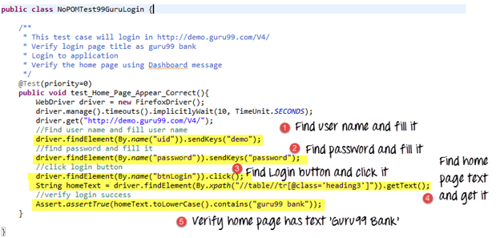
Page Object Model
(POM)
Why POM? -

Slide 6
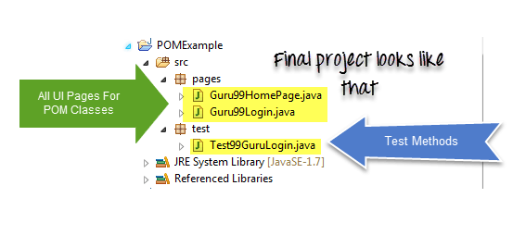
Page Object Model
(POM)
What is POM? –
  Design pattern.
  For each web page in the application, there should be corresponding page class.
It helps make the code more-
  Maintainable (Radio Box to DropDown?)
  Readable
  Reusable.

Slide 7
Functional Scenario
Login to App -> Homepage
Navigate to Patient Master
  Enter Patient Info
Navigate to Patient Report
  Verify Address of Patient
  Action Involved - ?

Slide 8
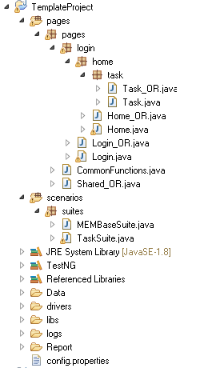
Folder Structure of
Components
Based on POM

Slide 9
Function Library
Mem Profile – Enter FirstName
  Verify if TextBox is present
  Clear TextBox
  EnterData using SendKeys
How many controls @ Mem Profile?
Need to add SetFocus - ?

Slide 10
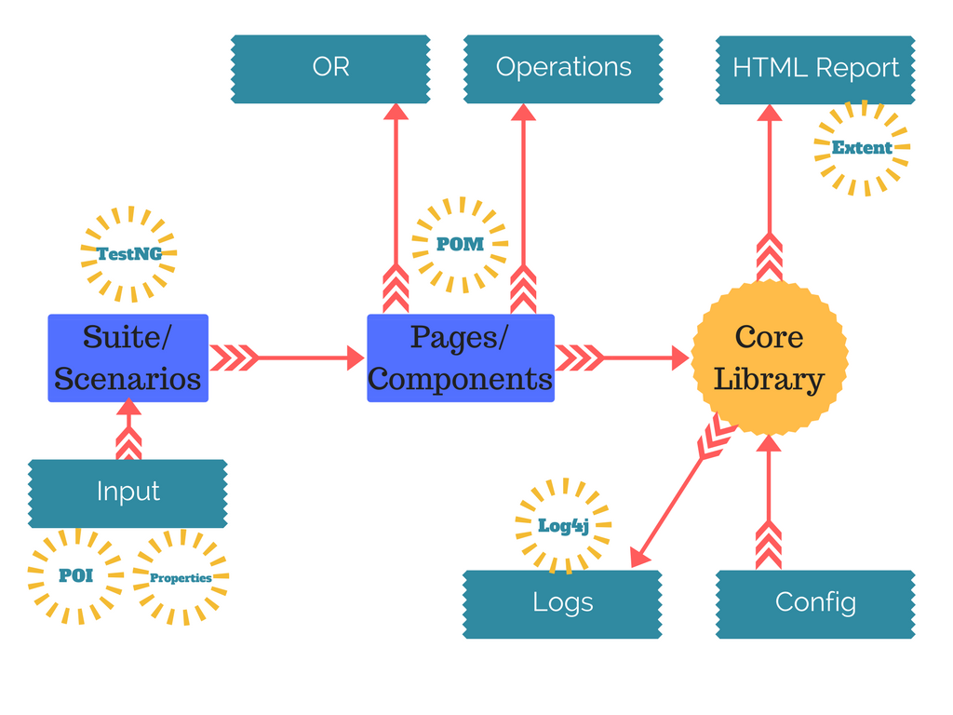
Framework
Architecture

Slide 11
FrameWork
Top 3 Advantages
  Reusability (using Library Functions)
  Uniform Approach
  Independent of App

Slide 12
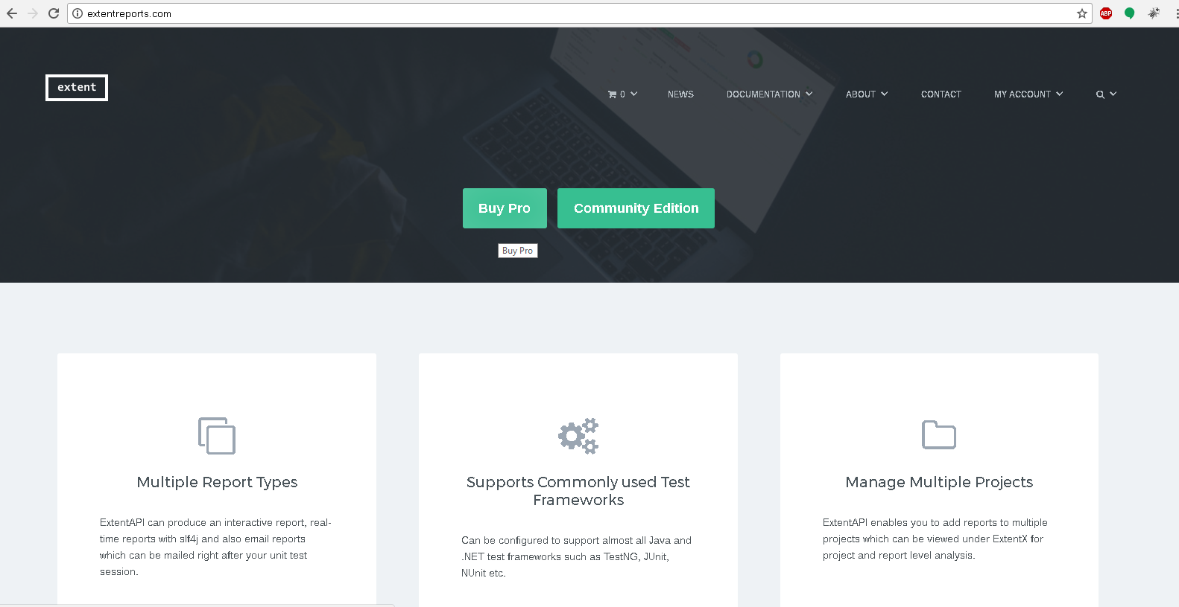
Reporting –
Extent Report

Slide 13
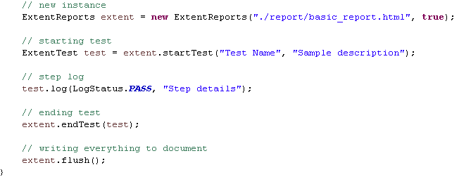
Reporting –
Extent Report

Slide 14
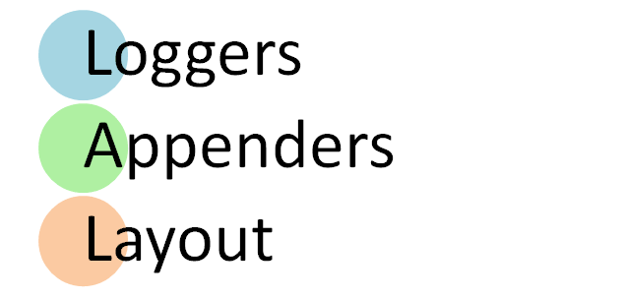
Logging –
Log4J

Slide 15
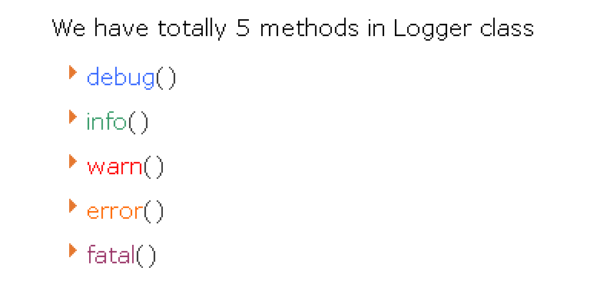
Logging –
Log4J

Slide 16
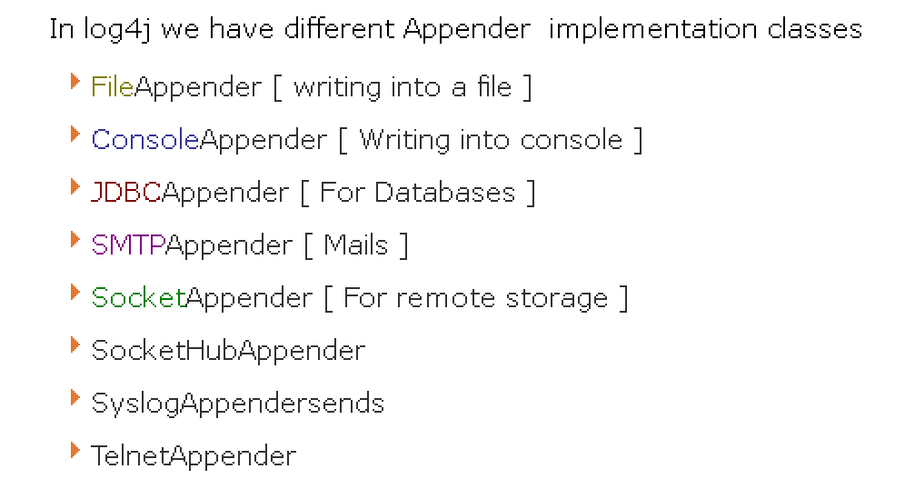
Logging –
Log4J

Slide 17
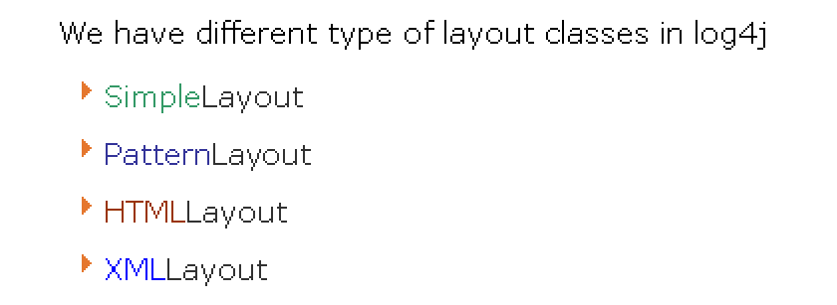
Logging –
Log4J

Slide 18
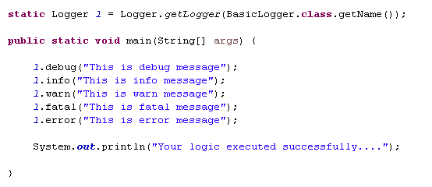

Logging –
Log4J

Slide 19
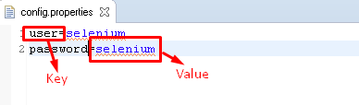
Data Management – POI
& Properties file
Java properties file is used to store project configuration data or settings.

Slide 20
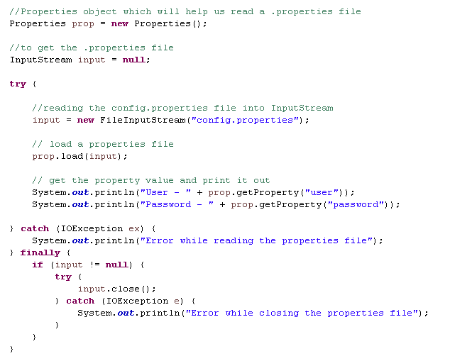
Data Management – POI
& Properties file

Slide 21
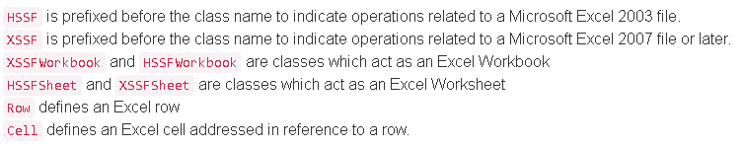
Data Management – POI
& Properties file
Apache POI is the pure Java API for reading and writing Excel files in both formats XLS (Excel 2003 and earlier) and XLSX (Excel 2007 and later).

Slide 22
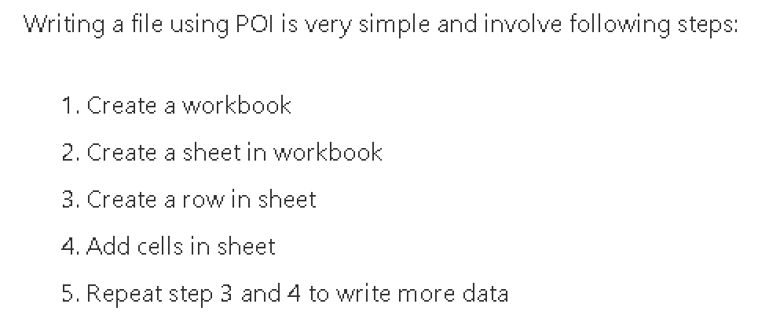
Data Management – POI
& Properties file

Slide 23
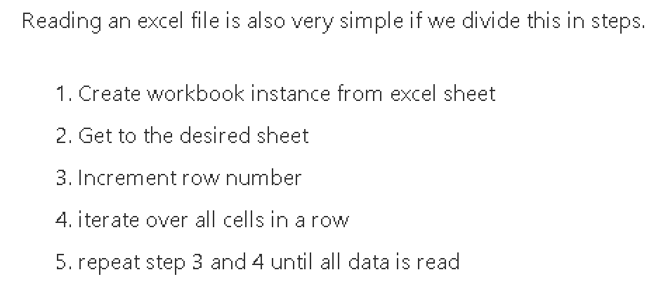
Data Management – POI
& Properties file

Slide 24


Slide 25
Knowledge Check
Brief POM, How we should maintain pages/components?
Why we need reporting?
What are loggers in Log4J?
What are Appenders in Log4J?
What are layouts in Log4J?
How we can manage key, value pair data in Java?
How read Excel data in Java? difference between HSSF vs XSSF?

Slide 26

Thank you!

